Slide 1

INFOSYS SPRINGBOARD VIRTUAL INTERNSHIP 6.0

Slide 2

Project on AI-Powered Identity Verification and Fraud Detection for KYC Compliance

Slide 3
introduction:-
Ensures customer identity is verified digitally using AI instead of manual checking.
Detects fake, tampered, or forged documents during the KYC process.
Uses face matching and data analysis to confirm that the person is genuine.
Identifies suspicious patterns to prevent fraud and financial crimes.
Makes the KYC process faster, more accurate, and more secure for organizations.

Slide 4
Existing SYSTEM
Existing System (Traditional / Current Research)
1. Manual & Rule-Based KYC Verification
Most older systems rely on manual document checks, visual inspection of IDs, and static rules (e.g., “if ID matches, approve”).
These are slow, error-prone, and easy to bypass with forged documents.
2. Basic Biometric Verification
Current digital KYC uses OCR for extracting data and facial recognition for matching photos from documents to selfies.
These systems improve automation but struggle against advanced spoofing (deepfakes, synthetic faces).
3. Traditional Machine Learning Models
Some systems apply ML algorithms (like decision trees, SVMs, or simple anomaly detectors) for fraud spotting.
These often lack adaptability to evolving fraud patterns and can fail in real-time detection.
4. Separate Fraud Detection
Often fraud detection (transaction anomalies, AML rules) and KYC are handled independently, not integrated in a cohesive pipeline.
This can lead to blind spots where identity and behavior signals aren’t correlated effectively.

Slide 5
5. Real-Time & Privacy-Preserving Design
Emerging architectures aim to be real-time, scalable, and privacy friendly — combining AI with techniques like federated learning to preserve data security while still spotting fraud across distributed systems
6. High Operational Cost Traditional KYC systems require human verification teams, manual review processes, and physical document handling. This increases operational cost for banks and financial institutions.
7. Poor Scalability When the number of customers increases (for example during peak account openings), existing systems struggle to handle large volumes efficiently, leading to delays and customer dissatisfaction.

Slide 6
PROPOSED SYSTEM (Advanced AI-Driven Models from IEEE / Latest Research)
1. Multi-Modal AI Verification
Frameworks like “Zero-to-One IDV” propose combining document verification, biometric analysis, risk scoring, and orchestration as integrated layers. AI drives each layer with deep learning, making verification more accurate and robust.
2. Microservice AI Architecture
Recent research proposes agentic AI microservices that break down identity verification into modular tasks (OCR, deepfake detection, liveness tests). These micro-agents operate in real-time and escalate complex cases to humans if needed.
3. Deep Learning & Multi-Expert Models for Fraud
Hybrid deep models (e.g., combining RNNs, Transformers, autoencoders) dynamically detect anomalous behavior in transactions, supporting regulatory compliance (including KYC and AML) and adapting to evolving fraud patterns.
4. Behavioral Biometrics & Dynamic Features
Proposed systems integrate behavior signals (like keystroke dynamics, mouse movement, interaction patterns) with biometric verification to detect synthetic identities and advanced spoofing beyond static matching.
5. Real-Time & Privacy-Preserving Design
Emerging architectures aim to be real-time, scalable, and privacy friendly — combining AI with techniques like federated learning to preserve data security while still spotting fraud across distributed systems.

Slide 7



Existing system
Proposed system

Slide 8
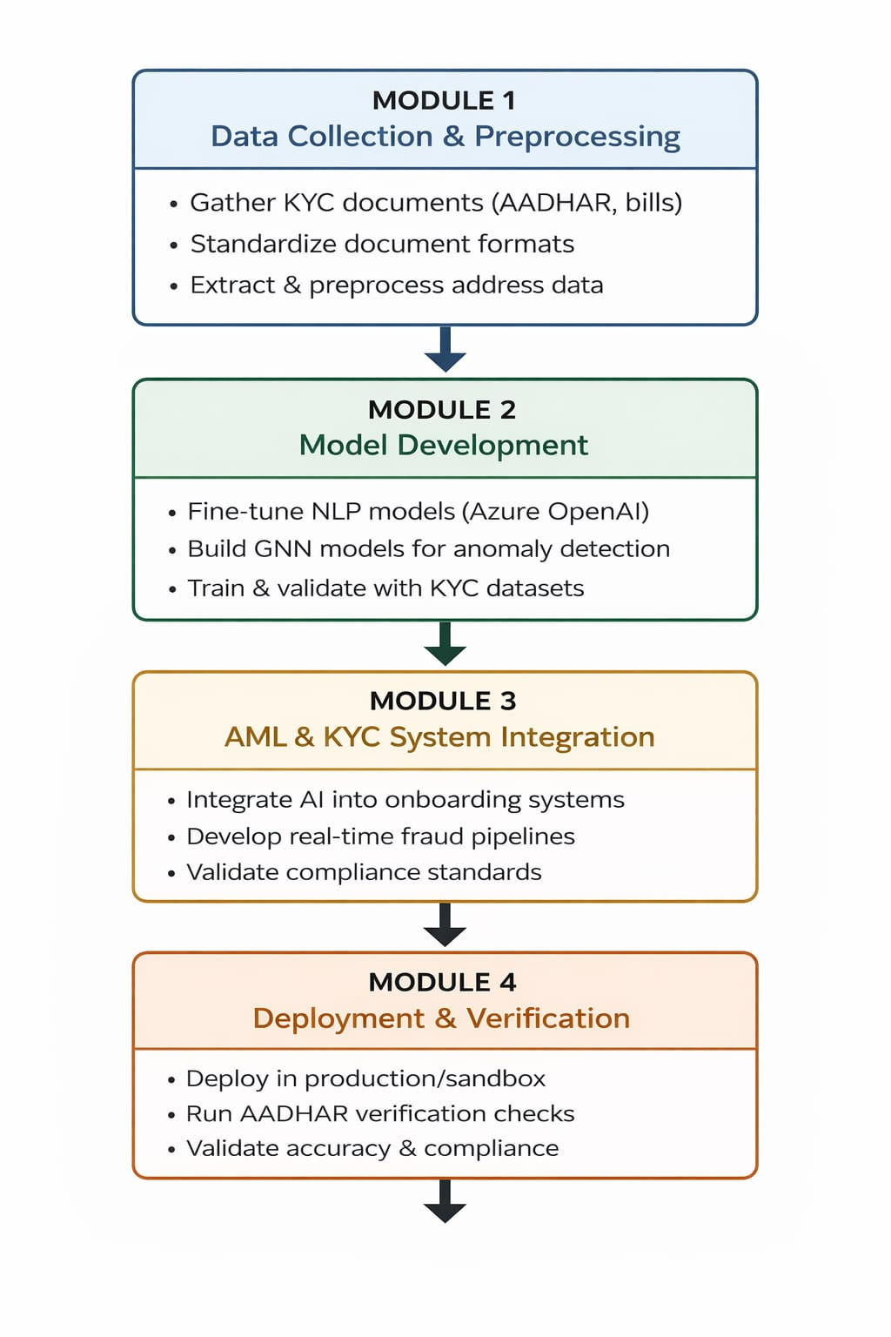
PROJECT DIVISION
MODULE -4
Project is divided into 4 module
and each modules have 2 things to perform:-
OBJECTIVE
TASK

Slide 9
MILESTONE
Milestone 1 – Data Preparation Completed "In the first milestone, we collected KYC documents like AADHAR and utility bills.We cleaned and standardized the data, extracted address details, and prepared structured datasets ready for AI model training.”
Milestone 2 – Model Development Completed "In the second milestone, we developed AI models including NLP for document analysis, GNN for anomaly detection, and computer vision for verification. The models were trained and evaluated to ensure accurate identity and address validation.”
Milestone 3 – System Integration Achieved "In the third milestone, we integrated the trained models into AML and KYC systems. We built a real-time fraud detection pipeline and validated the system against compliance standards.”
Milestone 4 – Deployment & Validation Completed "In the final milestone, we deployed the full system in a secure environment. We tested it using real AADHAR-based data to confirm fraud detection accuracy and regulatory compliance.”

Slide 10
MODULE AND MILETSTOME WHAT’S THE DIFFERENCE IN THIS AI POWERED IDENTIFICATION PROCESS
Modules (WHAT you are building)Modules are the project phases or functional parts of your system.
They describe what work needs to be done. In your project, the 4 Modules are:
Data Collection & Preprocessing
Model Development
AML & KYC System Integration
Deployment & Verification
Modules explain the process and tasks like collecting AADHAR data, building NLP/GNN models, integrating systems, and deploying.
Milestones are the completion checkpoints.
They show progress and results achieved after finishing each module.
In your project:
Milestone 1 → Data collected and cleaned
Milestone 2 → AI models developed and evaluated
Milestone 3 → Models integrated into AML/KYC system
Milestone 4 → Full system deployed and validated

Slide 11
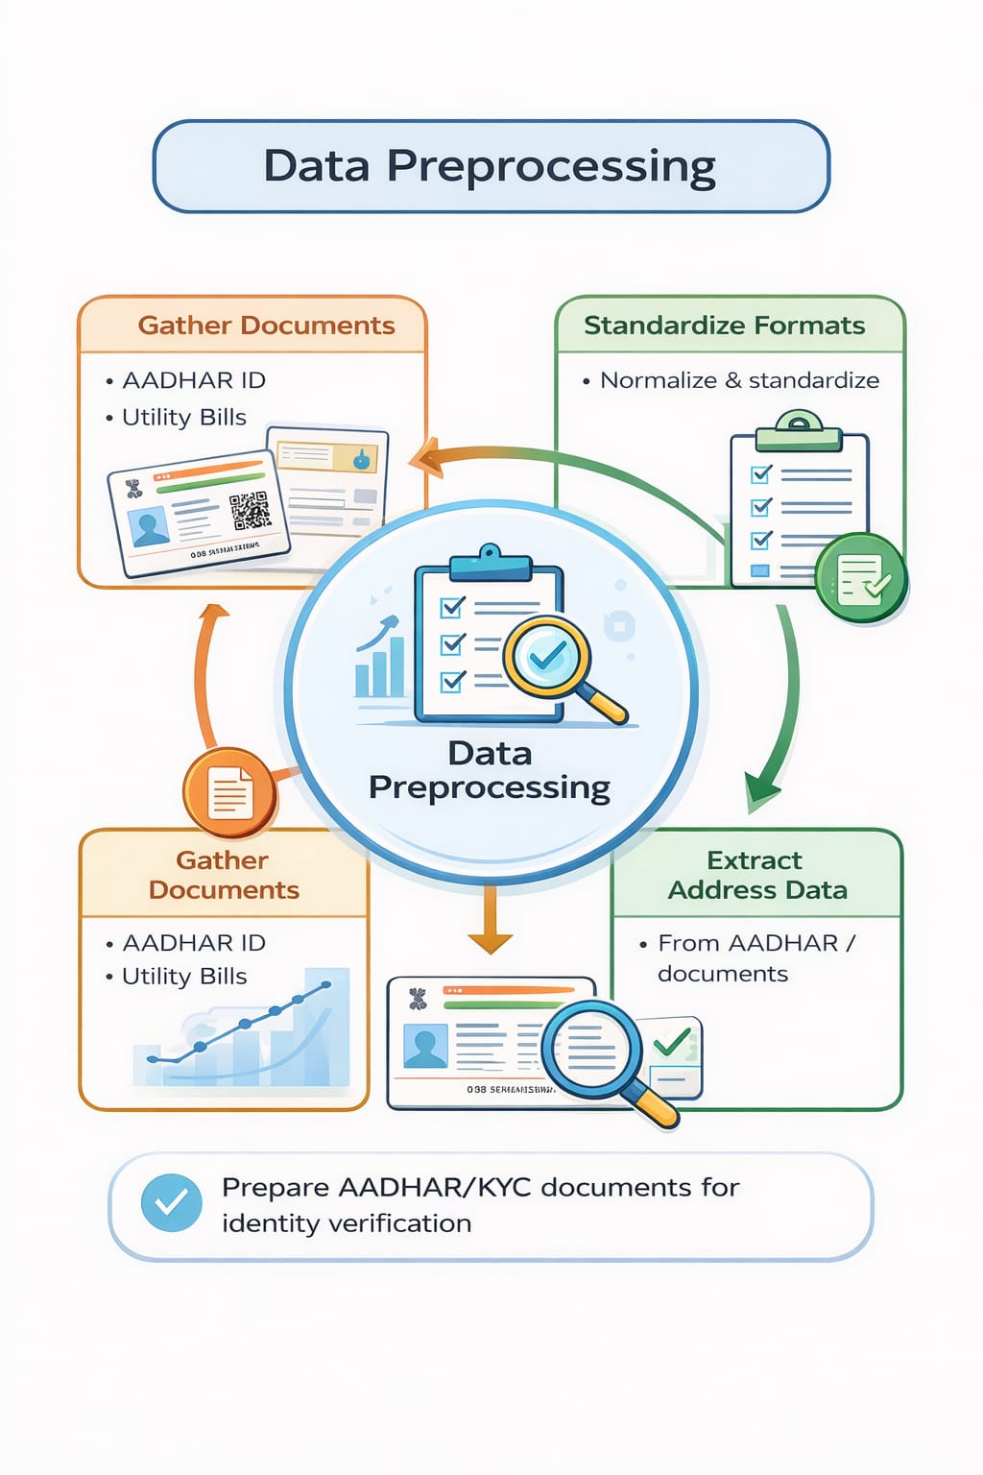
MODULE 1
DATA PREPROCESSING

Slide 12
What is data preprocessing?
Collection of raw data (AADHAR, KYC documents, bills).
Cleaning the data by removing errors, duplicates, or missing values.
Standardizing formats (dates, addresses, document structure).
Extracting important fields like name, address, ID number.
Converting unstructured data (images/PDFs) into structured format.
Transforming data into machine-readable format for AI models.
Ensuring data quality, consistency, and accuracy before model training.

Slide 13
What ARE the datasetS?
Custom KYC → Document verification
CASIA → Fraud/tampering detection
SROIE → OCR & text extraction
Selfie-ID → Face verification

Slide 14
AI-Based KYC Document Preprocessing and OCR Analysis
-
Using Image Processing & Tesseract OCR

Slide 15
What is Tesseract OCR?
Tesseract is a tool that performs Optical Character Recognition (OCR). Before applying OCR, document images are preprocessed to improve text clarity. Preprocessing removes noise and converts images to grayscale so that Tesseract can more accurately recognize characters.
not directly OCR is used because:-
Raw images may contain noise and color variations.
Preprocessing improves text visibility, which helps Tesseract produce better results.

Slide 16
Objective:-
The objective of this project is to:
Load KYC document images
Apply image preprocessing techniques
Extract text using OCR
Evaluate OCR output quality

Slide 17
Dataset Structure
Content
DATASET
Valid
The valid folder contains KYC document images that:
Are clear and readable
Have proper document structure
Contain visible text
Are suitable for OCR processing
Invalid
folder contains KYC document images that:
Are blurred or noisy
Have poor lighting
Contain partial or unclear text
Are unsuitable for reliable OCR

Slide 18
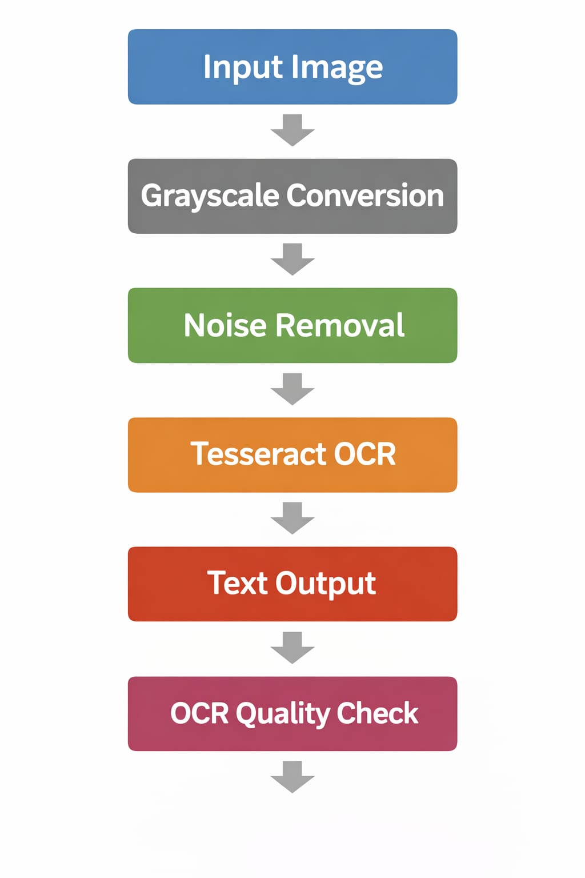
Project Workflow (Pipeline)

Slide 19
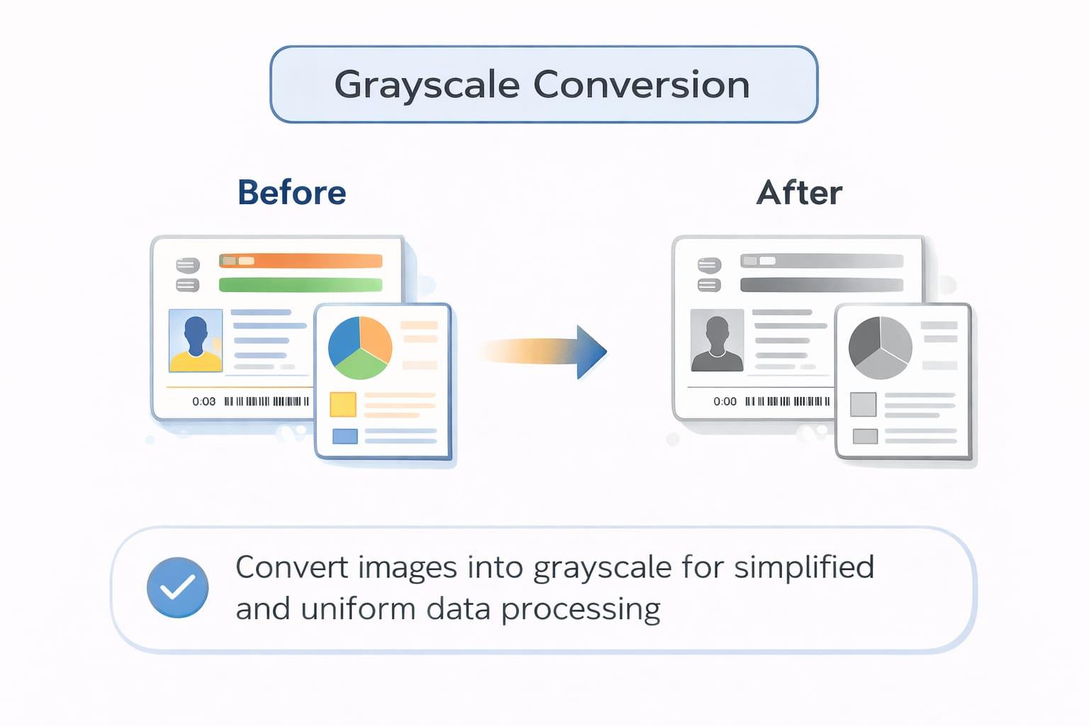
Grayscale Conversion
Reduces image complexity
Removes color information
Improves text clarity
Grayscale images help OCR focus only on text intensity.
Grayscale conversion removes color information and retains only intensity values. This reduces image complexity and helps highlight text regions more clearly. As a result, noise removal and OCR become more effective.

Slide 20
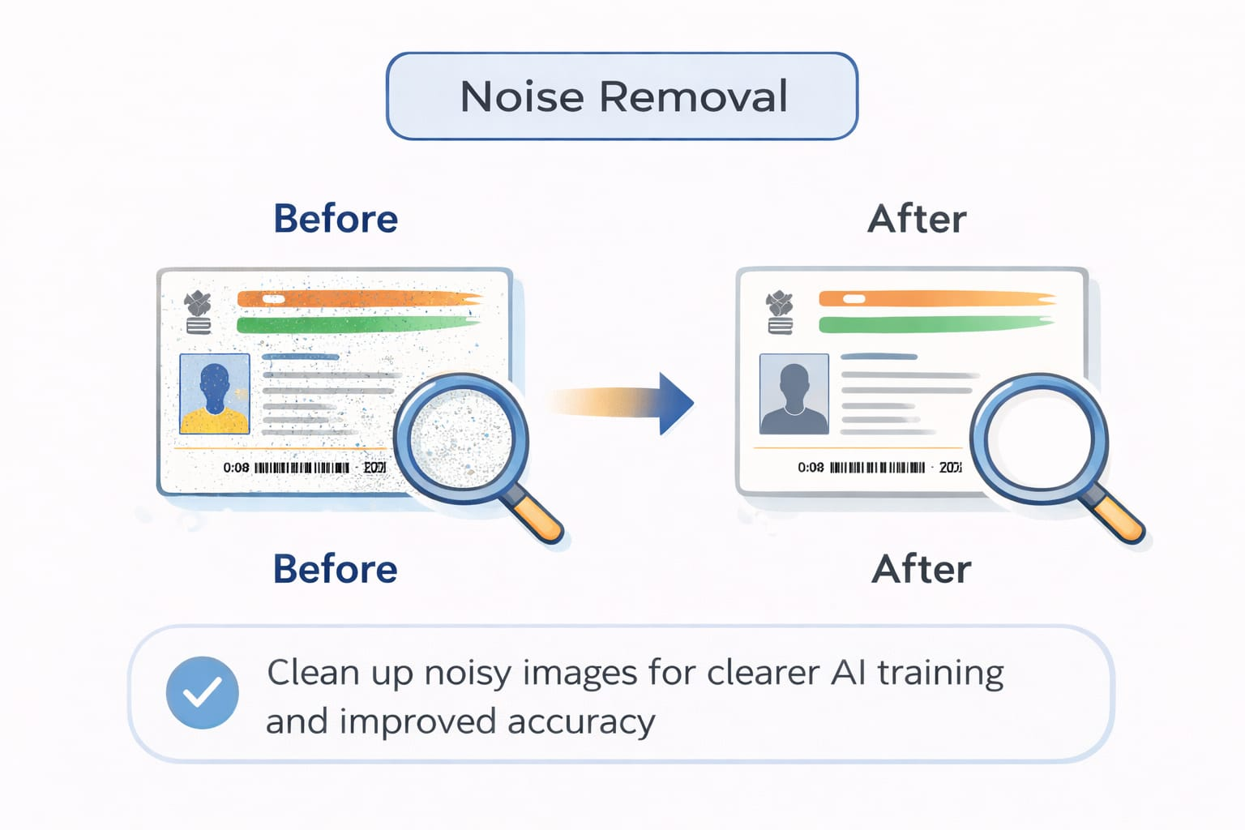
Noise Removal
Noise removal is an important preprocessing step applied after grayscale conversion to improve image quality. In KYC document images, noise may appear due to scanning issues, camera blur, uneven lighting, or background patterns.
Noise removal was applied after grayscale conversion.
Reduce unwanted distortions
Clean background
Improve text visibility

Slide 21
OCR Process
In this project, Optical Character Recognition (OCR) is used to extract textual information from KYC document images. Before applying OCR, the images are preprocessed using grayscale conversion and noise removal techniques.
Grayscale conversion simplifies the image by removing color information and retaining only intensity values, which enhances text visibility. Noise removal further cleans the image by reducing unwanted distortions, shadows, and background interference.
After preprocessing, Tesseract OCR is applied to convert the cleaned document images into machine-readable text. The extracted text quality depends on factors such as image clarity, resolution, lighting conditions, and document background.
A basic OCR quality evaluation is performed by analyzing the length of the extracted text. This helps determine whether the OCR output is meaningful or limited, reflecting real-world challenges in automated KYC verification systems.

Slide 22
Overall View
Some images produced clear text
Some images produced limited text
Image quality affects OCR performance
Lighting and resolution impact accuracy
This project demonstrates a simple KYC document processing pipeline using:
Image preprocessing
OCR extraction
Basic quality evaluation
The workflow shows how document quality directly affects OCR results.

